Slide 1

Mobile Back-End Assignment 4 How Uber Works?
Lee Sin Yi (M031920004)

Slide 2
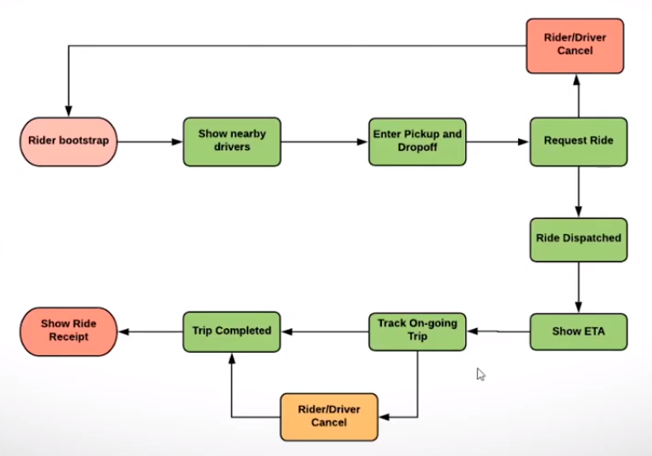
Uber is an app connecting riders and drivers.
In places where Uber operates, rider enter the pickup point and destination to request a ride through the app. When a nearby driver accepts the ride request, an estimated time of arrival for the driver to reach the pickup point of rider will be displayed in the app.

Slide 3
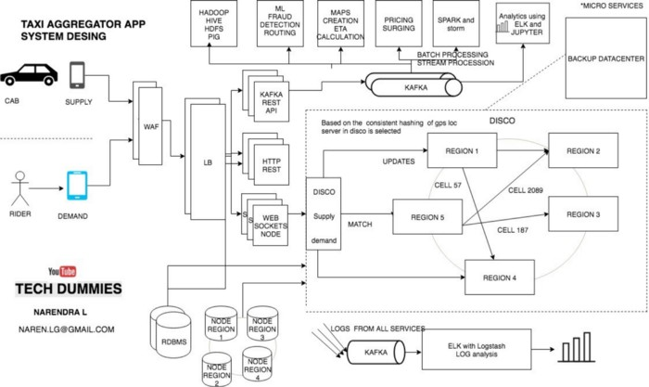

Slide 4
Technology of Uber may look simple but a giant infrastructure consisting of thousands of services and terabytes of data actually supports each and every trip on the platform behind the scenes.
Uber backend system started out as a “monolithic” software architecture with a bunch of app servers and a single database.
It was mainly written in Python and used SQLAlchemy as the ORM-layer to the database.
After 2014 the architecture has evolved into a Service-oriented architecture with about 100s of services.
Uber backend system is now designed to handle not only taxies, but food delivery and cargo too.
The backend is primarily serving mobile phone traffic. Uber app talks to the backend over mobile data.
Dispatch system of Uber acts like a real-time market platform that matches drivers with riders using mobile phones.
Thus, 2 services are needed, which is supply service and demand service.

Slide 5
Supply service | Demand service
Tracks cars using geolocation (lat and long) Every cab which is active keep on sending lat-long to the server every 5 sec once. | Tracks the GPS location of the user when requested.
The state machines of all of the supply also kept in memory | It tracks requirements of the orders made by rider like capacity of vehicle or carpool request.
To track vehicles there are many attributes to model: number of seats available/ allocation, type of vehicle, the presence of a car seat for children, can a wheelchair be fit, and so on. | Demand requirements must be matched against supply inventory.
With supply service and demand service, a service that can match the demand to a supply is called as DISCO in UBER.

Slide 6
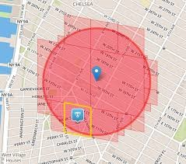
DISCO — DISPATCH optimization
This service runs on hundreds of processes.
Core requirements of the dispatch system
reduce extra driving
reduce waiting time
lowest overall ETA
The earth is a sphere. It is hard to do summarization and approximation purely based on longitude and latitude. So Uber divides the earth into tiny cells using the Google S2 library. Each cell has a unique cell ID.
S2 can give the coverage for a shape. If a circle with a 1km radius centred on London is to be drawn, S2 is able to tell which cells are needed to cover the circle completely .

Slide 7
Since each cell has an ID, the ID is thus being used as a sharding key. When a location comes in from supply, the cell ID for the location is determined. Using the cell ID as a shard key, the location of the supply is updated. It is then sent out to a few replicas.
To match riders to drivers or just display cars on a map, DISCO sends a request to geo by supply. The system will filter all drivers by GPS location data of riders to get the nearby drivers that meet requirements of riders.
With the cell IDs in the circle area determined by S2, all the relevant shards are contacted to return supply data. The list and requirements are sent to routing / ETA to compute the ETA of how nearby they are. After being sorted by ETA, it is being sent back to supply system to offer it to a driver.
Routing and Calculating ETA is important component as it directly impacts ride matching and earnings. It uses historical travel times to calculate ETAs. AI simulated algorithms or simple Dijkstra's can also be used to find the best route. GPS location data of driver can predict traffic condition at any given road easily as there are so many drivers on the road who are sending their GPS locations through the app every 4 seconds.

Slide 8
Every cab will send location through Web application gateway / firewall , load balancer to the Kafka REST Api which gets consumed to different places as required, database and DISCO to keep the latest cab location.
There are different servers in a ring which are assigned responsibilities of different hashed cell index and hence the data is stored accordingly. These servers are in architecture called Ring Pop and they are equally distributed with loads when new servers are added or servers are taken down.
For logging, we use multiple Kafka clusters, and the data is archived into Hadoop and/or a file storage web service before it expires from Kafka. This data is also ingested in real time by various services and indexed into an ELK stack for searching and visualizations (ELK stands for Elasticsearch, Logstash, and Kibana).
Web Sockets have been kept for ease of communication between the clients and the demand/supply system management (DISCO) or any component in the server. This is written in Node.Js as this is good in asynchronous messaging, small messaging and event driven enabled.

Slide 9
At the lower levels, engineers of Uber primarily write in Python, Node.js, Go, and Java. Uber was started with 2 main languages, Node.js for Marketplace team, and Python for everyone else. These first languages still power most services running at Uber today.
Go and Java are adopted for high performance reasons. Java takes advantage of the open source ecosystem and integrates with external technologies, like Hadoop and other analytics tools. Go provides efficiency, simplicity, and runtime speed.
Older Python code is being ripped out and replaced as the original code base being break up into microservices. An asynchronous programming model gives better throughput. Tornado is used with Python, but native support of Go for concurrency is ideal for most new performance-critical services.
Those working at the top of the stack write in languages beyond Java, Go, Python, and Node.

Slide 10
Storage
On the back end, the standard Schemaless and MySQL is being used, gradually being moved toward all-Schemaless.
As each cab sends request every 4 seconds, this will be write heavy application and read heavy application to manage rider request.
To enable intense operations with nearly zero downtime irrespective of adding nodes, taking backup or system goes down. Data center is built in nearest place to the region established to ensure faster response.
For distributed storage and analytics for complex data, a Hadoop warehouse is used.
Redis is used for both caching and queuing. Twemproxy provides scalability of the caching layer without sacrificing cache hit rate via its consistent hashing algorithm. Celery workers process async workflow operations using those Redis instances.

